Slide 1
Lecture 11
Digital Logic Design

Slide 2
multiplexer
A multiplexer (MUX) is a device that allows digital information from several sources to be routed onto a single line for transmission over that line to a common destination. The basic multiplexer has several data-input lines and a single output line. It also has data-select inputs, which permit digital data on any one of the inputs to be switched to the output line. Multiplexers are also known as data selectors.

Slide 3
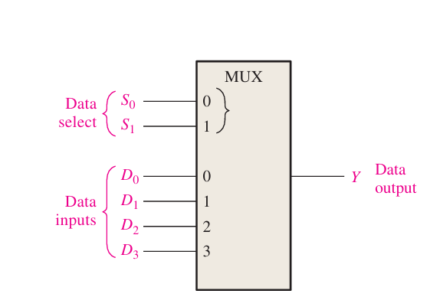

Slide 4
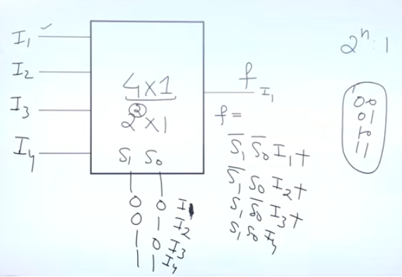

Slide 5
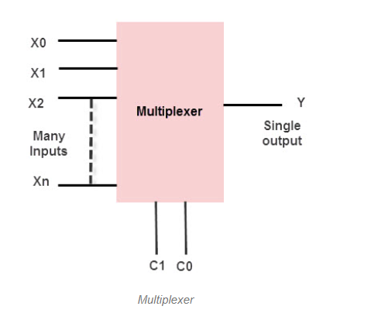
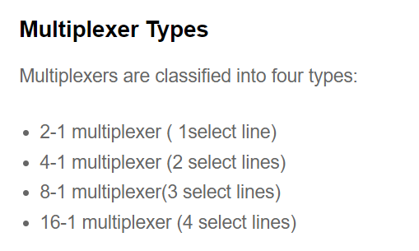
MUX:-
Multiplexer refers to a type of combinational circuit that accepts multiple inputs of data but provides only a single output.

Slide 6
Applications of Multiplexers
Multiplexers are used in various applications wherein multiple-data need to be transmitted by using a single line.
Communication System
A communication system has both a communication network and a transmission system. By using a multiplexer, the efficiency of the communication system can be increased by allowing the transmission of data, such as audio and video data from different channels through single lines or cables.
Computer Memory
Multiplexers are used in computer memory to maintain a huge amount of memory in the computers, and also to reduce the number of copper lines required to connect the memory to other parts of the computer.
Telephone Network
In telephone networks, multiple audio signals are integrated on a single line of transmission with the help of a multiplexer.
Transmission from the Computer System of a Satellite
The multiplexer is used to transmit the data signals from the computer system of a spacecraft or a satellite to the ground system by using a GSM satellite.

Slide 7
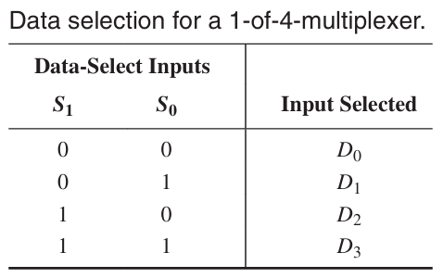
In Figure, a 2-bit code on the data-select (S) inputs will allow the data on the selected data input to pass through to the data output. If a binary 0 (S1 = 0 and S0 = 0) is applied to the data-select lines, the data on input D0 appear on the data-output line. If a binary 1 (S1 = 0 and S0 = 1) is applied to the data-select lines, the data on input D1 appear on the data output. If a binary 2 (S1 = 1 and S0 = 0) is applied, the data on D2 appear on the output. If a binary 3 (S1 = 1 and S0 = 1) is applied, the data on D3 are switched to the output line. A summary of this operation is given in table.

Slide 8
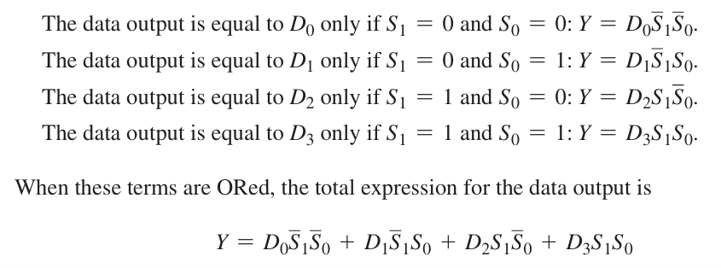
Now let’s look at the logic circuitry required to perform this multiplexing operation. The data output is equal to the state of the selected data input. You can therefore, derive a logic expression for the output in terms of the data input and the select inputs.

Slide 9
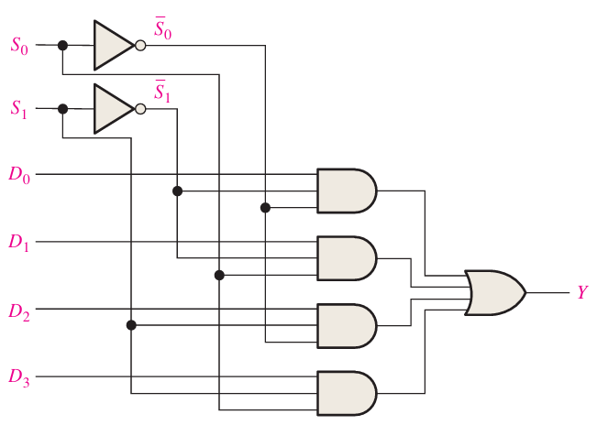
The implementation of this equation requires four 3-input AND gates, a 4-input OR gate, and two inverters to generate the complements of S1 and S0, as shown in Figure. Because data can be selected from any one of the input lines, this circuit is also referred to as a data selector.

Slide 10
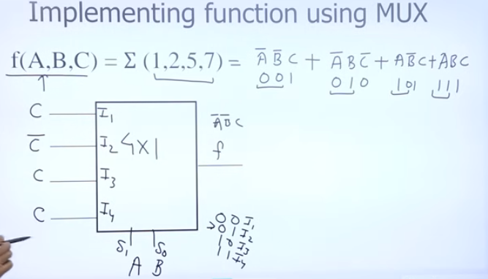

Slide 11
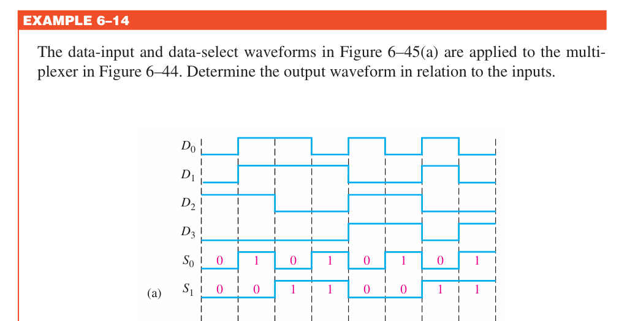

Slide 12
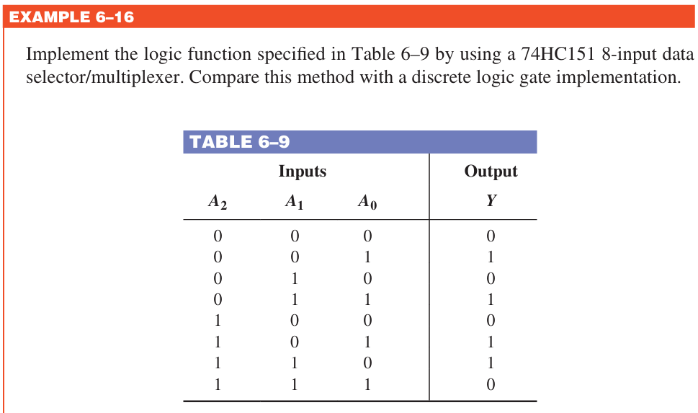

Slide 13
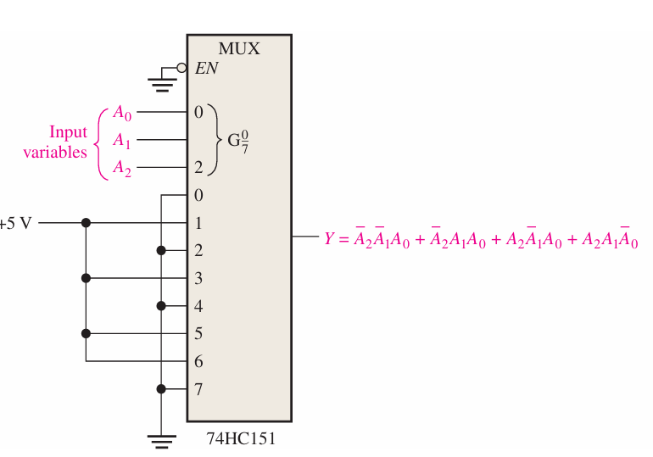

Slide 14
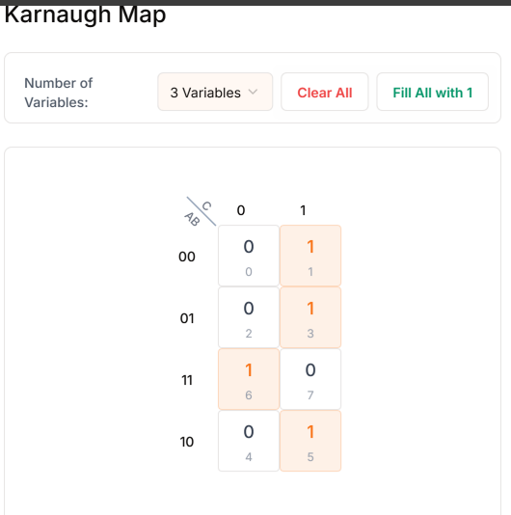
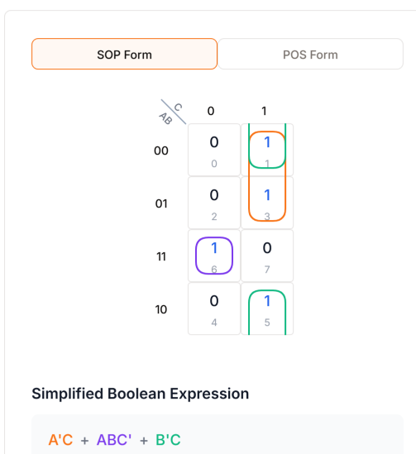

Slide 15
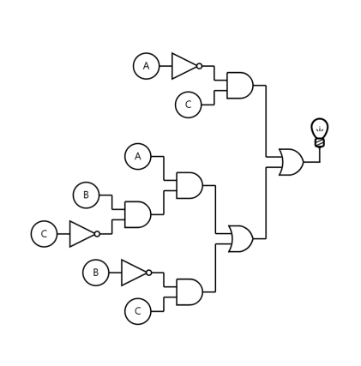

Slide 16
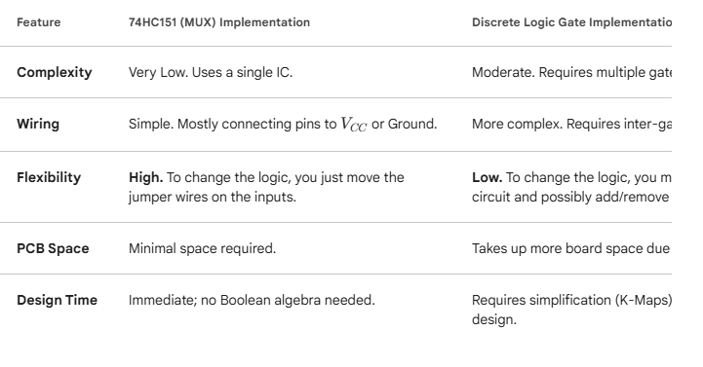

Slide 17
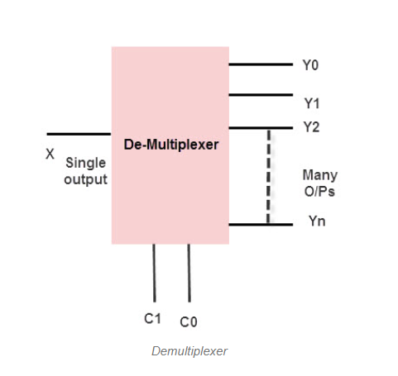
What is De-multiplexer?
De-multiplexer is also a device with one input and multiple output lines. It is used to send a signal to one of the many devices. The main difference between a multiplexer and a de-multiplexer is that a multiplexer takes two or more signals and encodes them on a wire, whereas a de-multiplexer does reverse to what the multiplexer does.
Types of De-multiplexer
De-multiplexers are classified into four types
1-2 de-multiplexer (1 select line)
1-4 de-multiplexer (2 select lines)
1-8 de-multiplexer (3 select lines)
1-16 de-multiplexer (4 select lines)

Slide 18

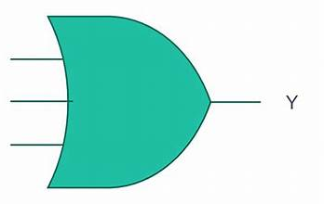

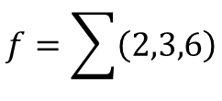




Implement $f=\overline{A}B+B\overline{C}$using decoder/demux.
$$f=\overline{A}B+B\overline{C}$$
$$f=\overline{A}B\left(C+\overline{C}\right)+B\overline{C}\left(A+\overline{A}\right)$$
$$f=\overline{A}BC+\overline{A}B\overline{C}+AB\overline{C }+\overline{A}B\overline{C}$$
$$f=\overline{A}BC+\overline{A}B\overline{C}+AB\overline{C }$$
3 X 8 DECODER
$$f=\sum{\left(2,3,6\right)}$$
A
B
C

Slide 19
Applications of De-multiplexer:-
De-multiplexers are used to connect a single source to multiple destinations. These applications include the following:
Communication System
Mux and de-mux both are used in communication systems to carry out the process of data transmission. A De-multiplexer receives the output signals from the multiplexer and at the receiver end, it converts them back to the original form.
Arithmetic Logic Unit
The output of the ALU is fed as an input to the De-multiplexer, and the output of the de-multiplexer is connected to multiple registers. The output of the ALU can be stored in multiple registers.
Serial to Parallel Converter
This converter is used to reconstruct parallel data. In this technique, serial data is given as an input to the De-multiplexer at a regular interval, and a counter is attached to the de-multiplexer at the control input to detect the data signal at the output of the de-multiplexer. When all data signals are stored, the output of the de-mux can be read out in parallel.

Slide 20
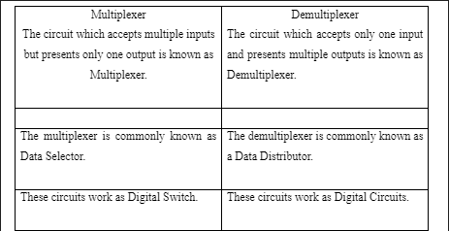
Difference between MUX & DE-MUX ?

